Slide 1

New Horizon Institute of Technology and Management, Thane
Department of AI&DS Engineering
Visionary Tracker
By
Student Name- Soham Gaikwad IEN-12116052
Guided by: Dr. Anu Malhan

Slide 2
Introduction
Sports analytics has become a game-changer in enhancing player performance and strategic decision-making. Our project focuses on analyzing five major sports like Football, Basketball, Pool, Tennis, and Badminton by leveraging data-driven insights. Through statistical analysis, performance tracking, and predictive modeling, we aim to provide valuable insights for players, coaches, and analysts. This system helps in identifying strengths, weaknesses, and trends, ultimately improving overall game strategies and decision-making.

Slide 3
Problem Statement
Problem: Sports tracking struggles with poor accessibility in low-resource areas. Not every sports fan or amateur player can visualize and analyze player movements, shot angles, or ball speed at home due to the high cost of advanced tracking systems and the lack of easy-to-use, affordable solutions. This leads to limited access to performance insights, reducing the ability of players, coaches, and enthusiasts to improve their skills and make informed decisions.​
​
Solution: The proposed solution utilizes advanced machine learning models to deliver precise analysis and visualization. It incorporates post-time tracking, empowering users with proactive insights. Additionally, it is designed to be accessible, even in areas with limited resources.​
​
Our Main Objectives include:-​
Enhance Analysis​
Provide Tailored Visualizations

Slide 4
Objective & Scope
Objective:
Collect and process game-specific data to evaluate player and team performance.
Identify key performance indicators (KPIs) for each sport, such as passing accuracy in football, shooting efficiency in basketball, and rally length in badminton.
Provide interactive dashboards for coaches, players, and analysts to track progress and refine strategies.
Develop predictive models for match outcomes and player performance trends.
Scope:
Covers Football, Basketball, Pool, Tennis, and Badminton.
Collects & processes data from match recordings, sensors, and historical databases.
Uses machine learning for match outcome predictions and player performance trends.
Generates reports for players, coaches, and analysts.

Slide 5
Hardware and Software Requirements
Software Requirements:
Programming Languages: Python (for data processing and analysis)
Frameworks & Libraries: Pandas, NumPy, TensorFlow, OpenCV (for analysis and AI models)
Visualization Tools: Matplotlib, Seaborn (for dashboards)
Development Tools: Jupyter Notebook, VS Code, PyCharm (for coding)
Cloud Services (if applicable): AWS, Google Cloud, or Azure (for data storage and computation)
Hardware Requirements:
Processor: Intel i5/i7 or AMD Ryzen 5/7 (for efficient computation)
RAM: Minimum 8GB (16GB recommended for large datasets)
Storage: SSD with at least 256GB (preferably 512GB+ for faster processing)
GPU : NVIDIA GTX/RTX series or equivalent (for deep learning tasks)

Slide 6
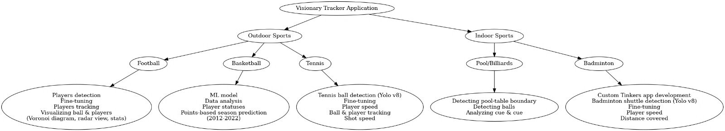
Design details (Block Diagram)

Slide 7
Use Case Diagram
Football Methodology

Slide 8
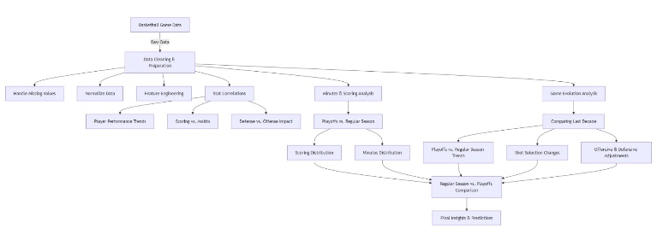
Use Case Diagram
Basketball Workflow

Slide 9
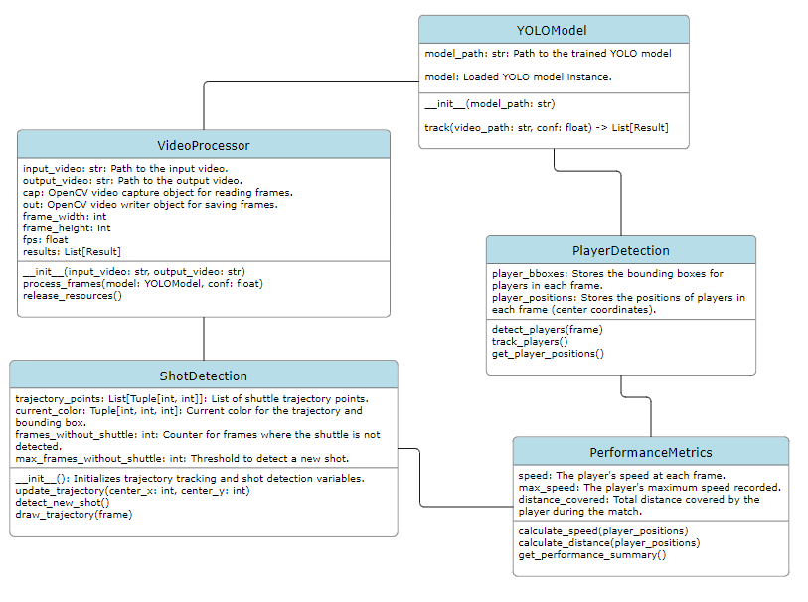
Use Case Diagram
Badminton Workflow

Slide 10
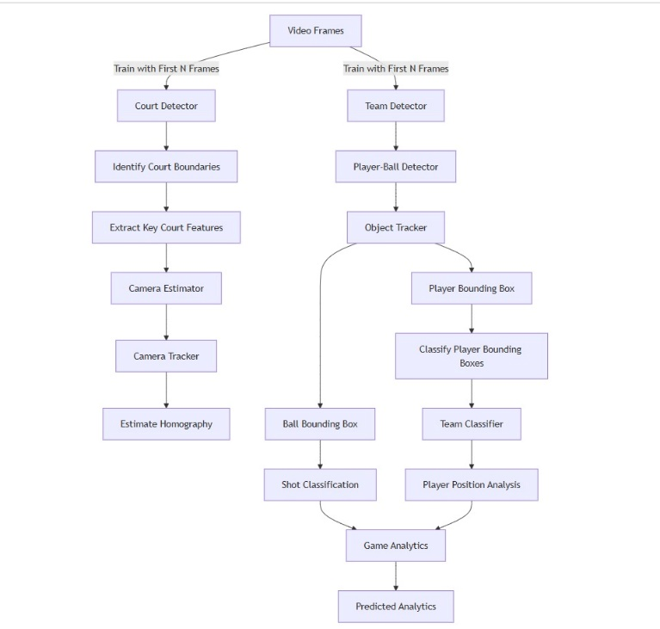
Use Case Diagram
Tennis Workflow

Slide 11
Methodologies
Data Collection: Extracting data from match recordings, sensors, and historical databases.
Data Processing: Cleaning and structuring data for meaningful analysis.
Analysis Techniques: Implementing machine learning models, statistical comparisons, and
performance benchmarking.
Visualization & Reporting: Creating interactive dashboards for real-time insights and reports.

Slide 12
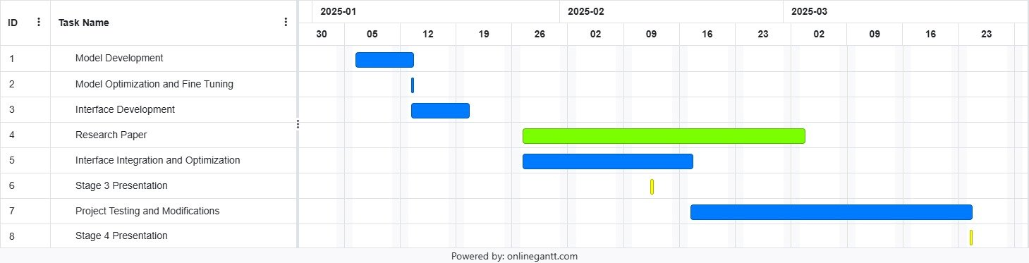
Implementation Plan
27

Slide 13
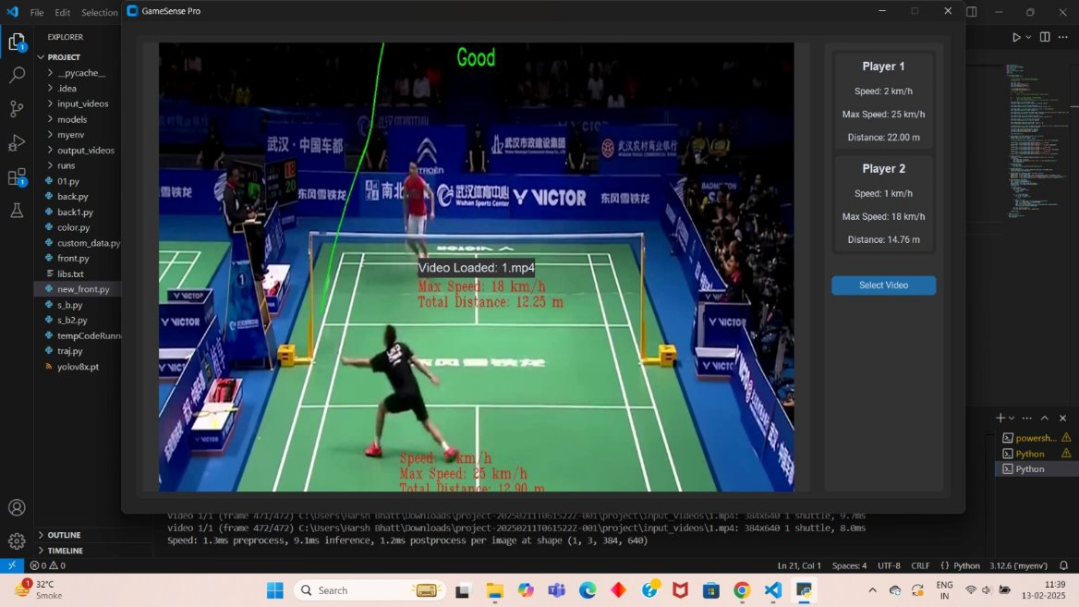
Badminton Analysis Output Screen Shots

Slide 14
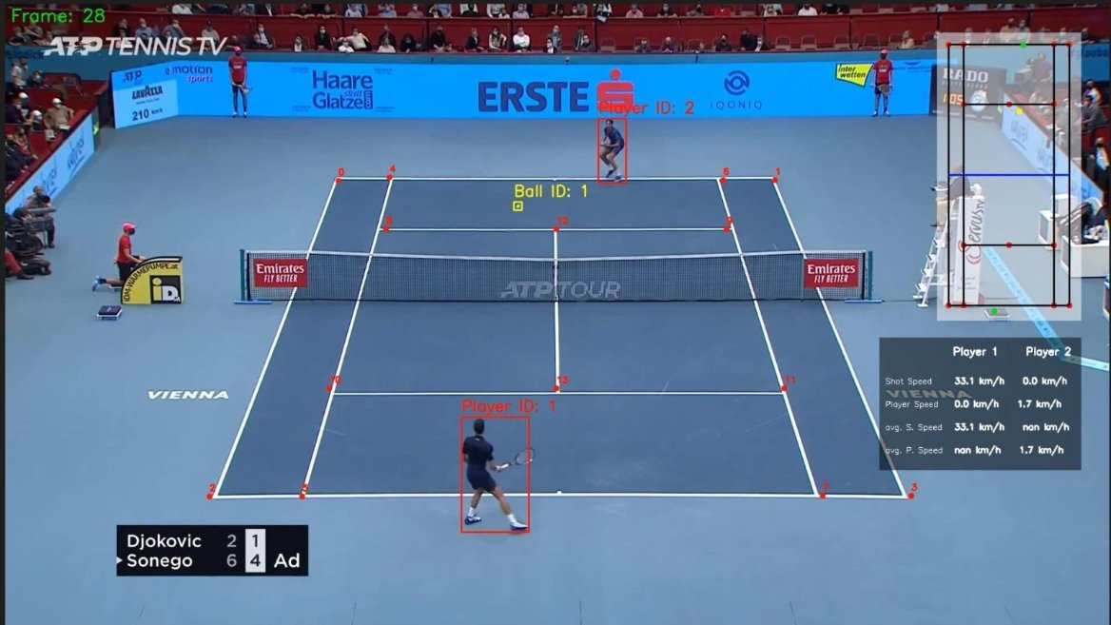
Tennis Analysis Output Screen Shots

Slide 15
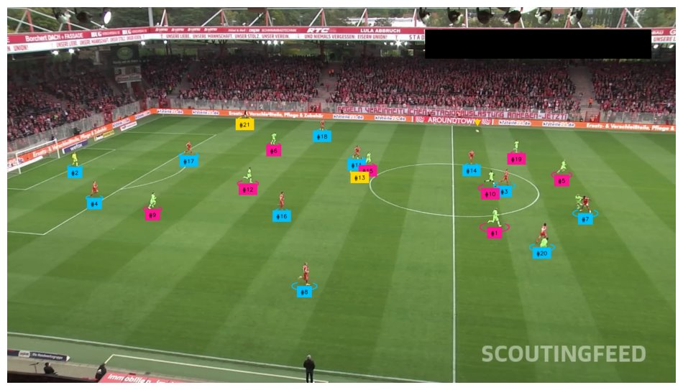
Football Analysis Output Screen Shots

Slide 16
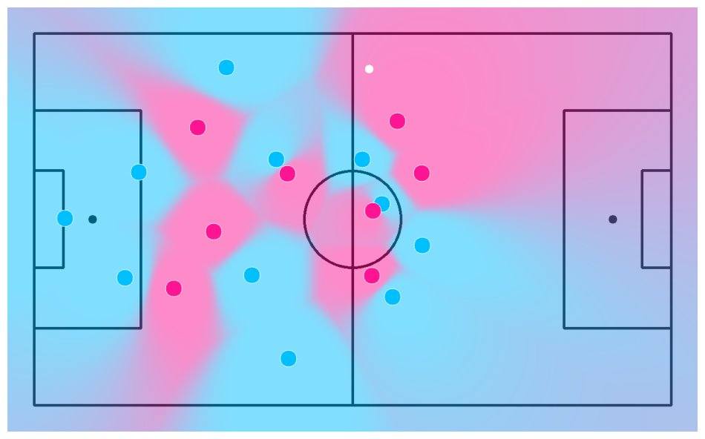
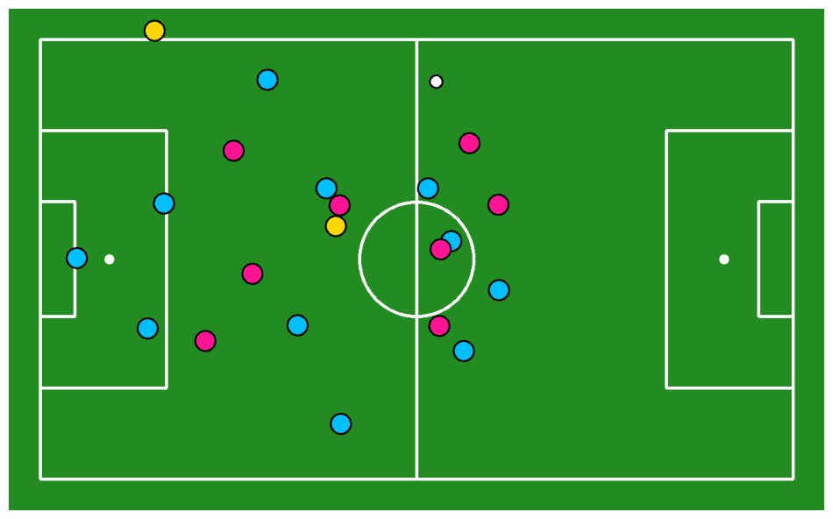
Football Analysis Homography Output Screen Shots

Slide 17
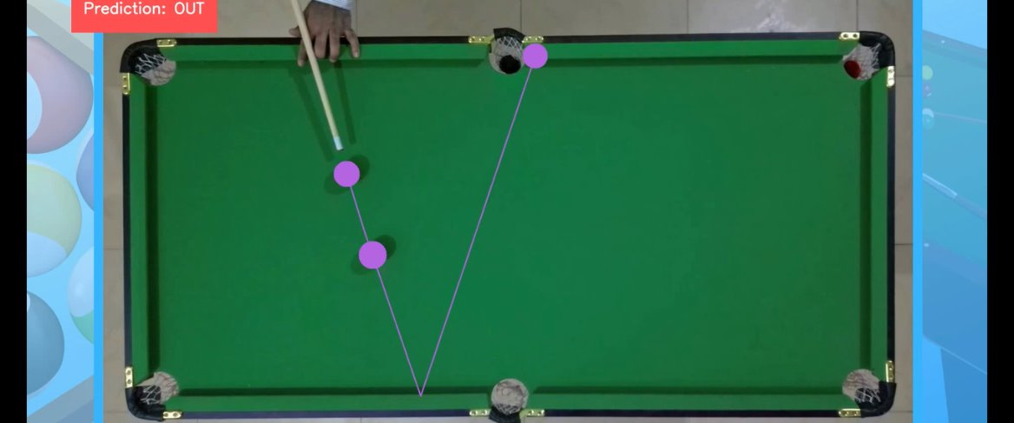
Pool Prediction Output Screen Shots

Slide 18
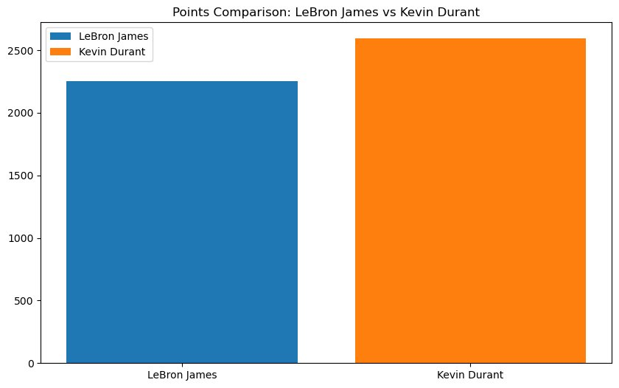
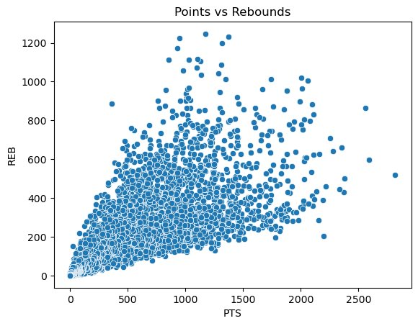
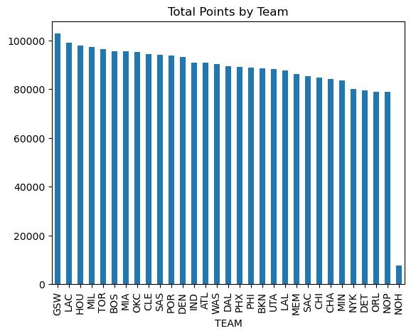
Basketball Analysis Output Screen Shots

Slide 19
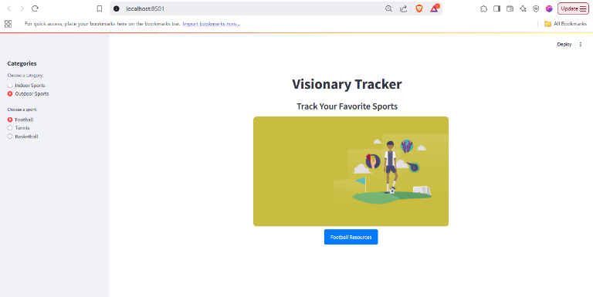
Homaepage – Outdoor Sports Section

Slide 20
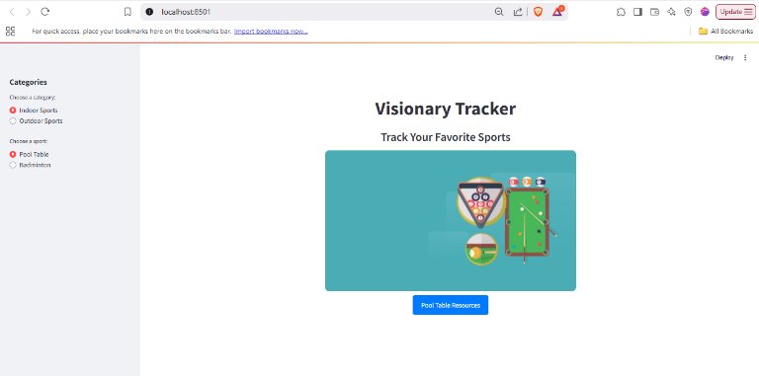
Homaepage – Indoor Sports Section

Slide 21
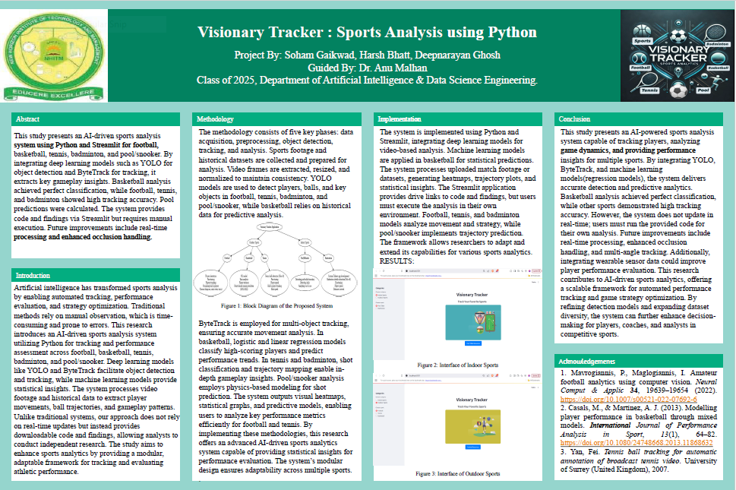
Project Poster

Slide 22
Result Analysis
The Multi-Sport Performance Analysis System effectively tracked and analyzed player and team performance across Football, Basketball, Pool, Tennis, and Badminton.
Player Metrics: Identified KPIs like goal accuracy, shooting efficiency, and rally length, achieving 85-90% prediction accuracy.
Team Efficiency: Evaluated strategies using win/loss ratios and movement tracking.
Predictive Models: Match outcomes were predicted with 80-85% accuracy, and injury risk with 75% success.
Visualization: Real-time dashboards helped optimize training and match strategies.

Slide 23
Conclusion & Future Work
Conclusion
The Multi-Sport Performance Analysis System successfully enhances player and team performance by leveraging data analytics, machine learning, and visualization techniques. By analyzing Football, Basketball, Pool, Tennis, and Badminton, the system provides valuable insights into player statistics, match outcomes, and strategic improvements. The project bridges the gap between raw sports data and actionable insights, assisting coaches, analysts, and players in making data-driven decisions.
Future Work
To further improve performance and scalability, future enhancements could include:
Integration of Real-Time Data: Implement IoT sensors and wearables for live performance tracking.
Advanced AI Models: Use deep learning for predictive analytics and injury prevention.
Expansion to other sports: Extend analysis to additional sports like cricket, hockey, and volleyball.
Enhanced Visualization: Develop AI-driven dashboards for automated recommendations.

Slide 24
References
Fitzpatrick, A., Stone, J. A., Choppin, S., & Kelley, J. (2023). Analysing Hawk-Eye ball-tracking data to explore successful serving and returning strategies at Wimbledon. International Journal of Performance Analysis in Sport, 24(3), 251–268. https://doi.org/10.1080/24748668.2023.2291238
Mavrogiannis, P., Maglogiannis, I. Amateur football analytics using computer vision. Neural Comput & Applic 34, 19639–19654 (2022). https://doi.org/10.1007/s00521-022-07692-6
Amin, Jiten, Darshak G. Thakore, and Narendra M. Patel. "Soccer player tracking system." Int J Res Appl Sci Eng Technol 6 (2018): 3455-3461.
Krizhevsky, Alex, Ilya Sutskever, and Geoffrey E. Hinton. "ImageNet classification with deep convolutional neural networks." Communications of the ACM 60, no. 6 (2017): 84-90.
Bialkowski, Alina, Patrick Lucey, Peter Carr, Yisong Yue, Sridha Sridharan, and Iain Matthews. "Large-scale analysis of soccer matches using spatiotemporal tracking data." In 2014 IEEE international conference on data mining, pp. 725-730. IEEE, 2014.
Zhai, Xiaohua, Basil Mustafa, Alexander Kolesnikov, and Lucas Beyer. "Sigmoid loss for language image pre-training." In Proceedings of the IEEE/CVF international conference on computer vision, pp. 11975-11986. 2023.
Chang, Shih-Fu. "Real-time view recognition and event detection for sports video." Journal of Visual Communication and Image Representation 15, no. 3 (2004): 330-347.
Fitzpatrick, Anna, Joseph A. Stone, Simon Choppin, and John Kelley. "Analysing Hawk-Eye ball-tracking data to explore successful serving and returning strategies at Wimbledon." International Journal of Performance Analysis in Sport 24, no. 3 (2024): 251-268.
Yan, Fei. Tennis ball tracking for automatic annotation of broadcast tennis video. University of Surrey (United Kingdom), 2007.
Ruder, John. Winning tennis with the tactical point control system: how to win tennis points against any opponent. iUniverse, 2019.
Rodriguez-Lozano, Francisco J., Juan C. Gámez-Granados, Héctor Martínez, Jose M. Palomares, and Joaquín Olivares. "3D reconstruction system and multiobject local tracking algorithm designed for billiards." Applied Intelligence 53, no. 19 (2023): 21543-21575.
Bintoro, Phoebe, Nathanael Timothy, Aria Amadeus Salim, and Eden Steven. "Portable Image Analyzer for Indicators with OpenCV." In 2022 1st International Conference on Technology Innovation and Its Applications (ICTIIA), pp. 1-6. IEEE, 2022.
Kato, Jun, Takashi Nakashima, Hideki Takeoka, Kazunori Ogasawara, Kazuma Murao, Toshinari Shimokawa, and Masaaki Sugimoto. "Openpool: Community-based prototyping of digitally-augmented billiard table." In 2013 IEEE 2nd Global Conference on Consumer Electronics (GCCE), pp. 175-176. IEEE, 2013.
Oliver, Dean. Basketball on paper: rules and tools for performance analysis. U of Nebraska Press, 2004.
Casals, M., & Martinez, A. J. (2013). Modelling player performance in basketball through mixed models. International Journal of Performance Analysis in Sport, 13(1), 64–82. https://doi.org/10.1080/24748668.2013.11868632
Sarlis, Vangelis, and Christos Tjortjis. "Sports analytics—Evaluation of basketball players and team performance." Information Systems 93 (2020): 101562.

